Slide 1
Solid Waste Committee Recommendations for 2019
Town
of
Canterbury
NEW HAMPSHIRE
V 16 October 23, 2018

Slide 2
Recommendations Summary

Slide 3
Recommendations
Separately recycle cardboard.
Replace our compactor truck with a stationary trash compactor and break-away container.
Rent a portable office before winter starts.
At our 2019 Town Meeting ask voters whether we should send mixed paper to the Wheelabrator trash-to-energy plant or continue to recycle it.
Establish two traffic lanes around the Transfer Station building.
Budget for minor site work, minor building modifications, and contingencies.

Slide 4
Associated costs or (savings)
# | Action | One Time Costs (Including installation and setup) | Annual Costs or (Savings)
1. | Separately recycle cardboard in large, dry bales to increase its recycling value. Requires a new baler and electrical upgrades. | New 60-inch, vertical baler: 10,000 Upgrade Unitil service to 400 A: 22,600 Upgrade building wiring: 11,000 New ground storage container: 4,500 Total: $ 48,100 | ($10,200)
2. | Replace our 20-year-old compactor truck with a stationary trash compactor and break-away container. Use a commercial hauler to take our container to/from the Wheelabrator plant, or a distant landfill in the future. | Compactor and Container: 33,400 Concrete pad: 3,200 Total: $ 36,600 | Hauling fees: $ 11,400 No change in tipping fees.
3. | Rent a mobile office container to replace the office in the Transfer Station building. Provides heat, A/C, and a secure door. Minor site work may be required. | Setup fee: $125 Minor site work: See 6. below | $ 1,800
4. | At our 2019 Town Meeting, ask voters whether we should send mixed paper to the Wheelabrator trash-to-energy plant or continue to recycle it. | 0 | ($2,400) Savings if we send mixed paper to Wheelabrator plant
5. | Establish two traffic lanes around TS building. | Minor site work: See 6. below | 0
6. | Budget for minor site work, minor building modifications, and contingencies. | $ 25,000 | 0

Slide 5
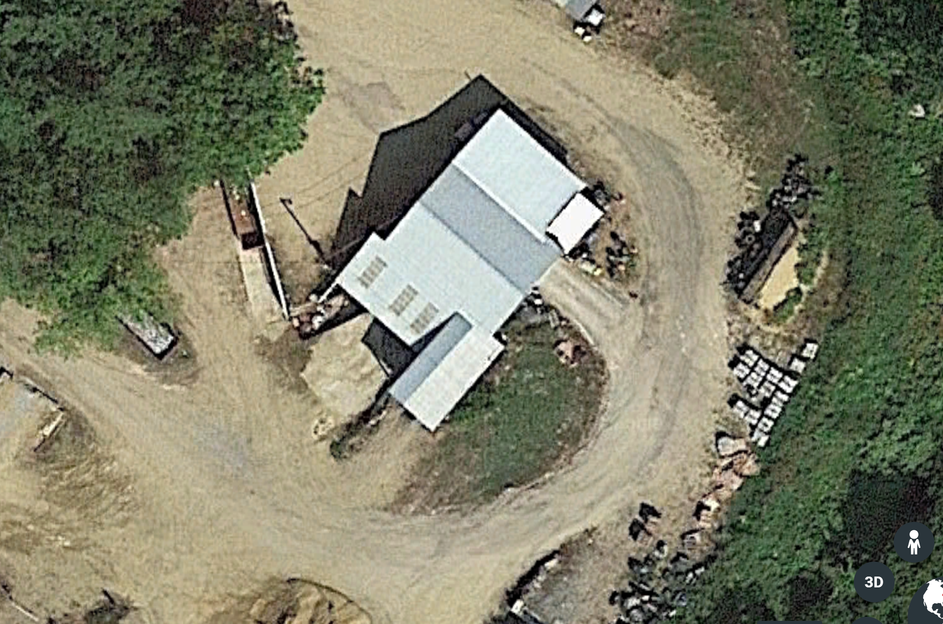
Proposed changes outside the building
Mobile Office
Const. Waste
Open Container
Scrap Steel
Open Container
Two lanes of traffic

Slide 6
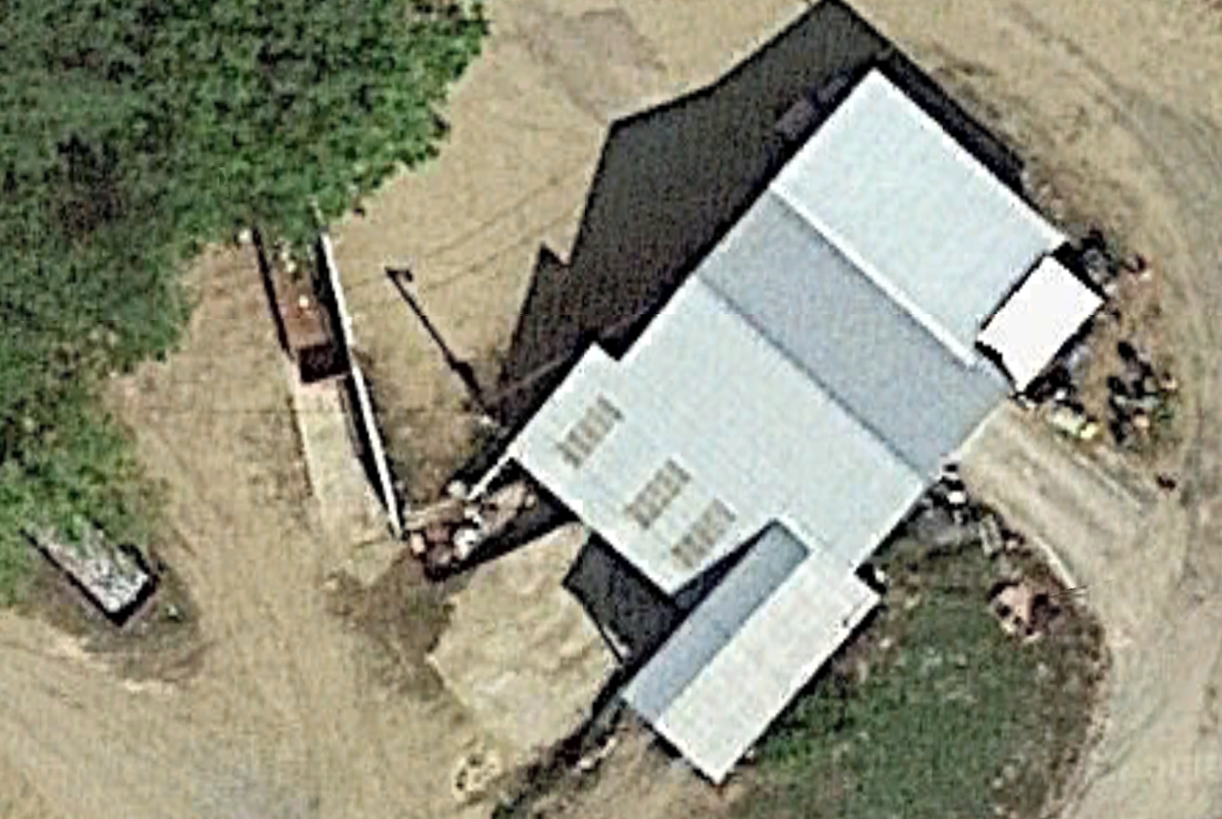
Proposed changes inside the building
New, large baler for cardboard
Loose Cardboard
Existing baler for Al and plastic
User paths
Const. Waste
Open Container
Al Cans Plastic
Vehicles
Storage
Scrap Steel
Open Container
Tin Cans
People
Glass Bottles
Mixed Paper?
Break-away
Container
Stationary compactor

Slide 7
Recommendation #1: Separately recycle cardboard
Requires a new 60-inch, ½ ton, vertical baler and electrical upgrades.
With an investment of $48k and annual savings of about $10k this recommendation has a payback period of about 5 years.

Slide 8
Separately recycle cardboard – Background
Currently we dispose of about 4 tons of mixed paper every 10 days, or about 12 tons per month. This stream includes both true mixed paper and cardboard, which is technically called old corrugated cardboard or OCC.
We estimate that our current mixed paper loads are about 40% OCC (cardboard) and 60% mixed paper.
Thus we generate about 5 tons of OCC and 7 tons of mixed paper per month.
Our cost to dispose of mixed paper (whether or not it includes OCC) is about $95 per ton.
If a mixed paper load is wet or snow-covered then we get charged a penalty on top of the $95/ton fee.

Slide 9
Separately recycle cardboard – Savings
Revenue for OCC, if recycled in large (½ ton), dry bales, is about $75/ton per 20-ton load, or about $1,500 per load.
If we purchase the baler needed to produce ½ ton bales and keep our OCC dry, we should generate 60 tons or 3 loads of high value OCC per year and thus an annual revenue of $ 4,500.
By not recycling OCC as mixed paper, we should save $5,700 per year in recycling cost. (5 tons/mo. x 12 mo. x $95/ton)
We estimate no extra staff hours will be required to bale cardboard, assuming 10 bales of cardboard per month and less time will be needed to compress the mixed paper container.
TS managers should verify this assumption.
Thus we estimate that separately recycling OCC will result in a net budget savings of $10,200 per year. ($4,500 + 5,700)

Slide 10
Separately recycle cardboard – Investment
The estimated cost to buy a 60-inch, vertical baler capable of creating standard ½ ton bales of OCC is $10,000.
The required baler needs more power than our current 100 A service can provide. Thus we will need Unitil to upgrade our electrical service to 400 A at a cost of $22,600.
We will need to upgrade building wiring to accept the 400 A service and bring power to the baler location at an estimated cost of $11,000.
We will need an additional storage container at a cost of $4,500.
Thus the total one-time investment needed to separately recycle OCC is estimated to be $48,100
As a first approximation, this investment would have a payback period of $48,100/$10,200 = 4.7 years.
The actual payback period should be slightly longer due to the Town’s borrowing costs. In any case it should be about 5 years.

Slide 11
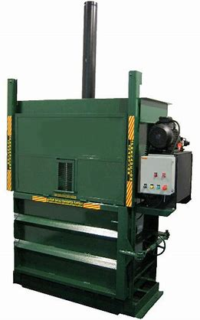
Vertical baler style we’re considering

Slide 12
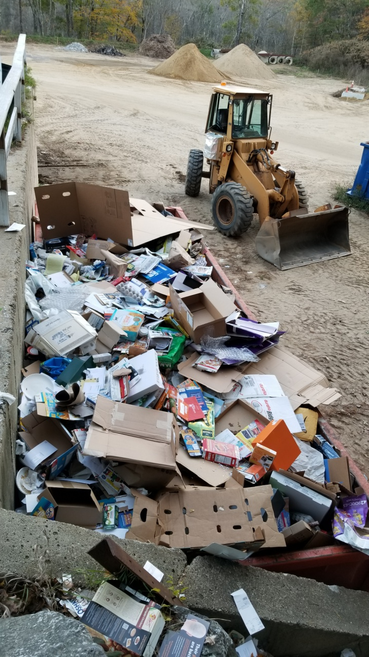
Our current OCC + mixed paper container

Slide 13
Separately recycle cardboard – Q & A
Why do we no longer need to have Unitil upgrade their line from the Center to the Transfer Station from single-phase to three-phase?
All of the new equipment we are proposing, including the large, vertical baler and stationary compactor (see Recommendation # 2) require three-phase power.
However, our equipment vendors have told us, and further research has confirmed, that such devices can be operated from single-phase power (split-phase 240 V to be exact) when they are equipped with a variable frequency drive or VFD.
What is a VFD?
Good question. Even the electrical engineer on the SWC had not heard of these devices before.
A VFD is a solid-state device (no moving parts) that is able to convert normal, household 240 V split-phase power into three-phase power, at the voltage needed by our compactor or baler.

Slide 14
Separately recycle cardboard – Q & A
Are VFDs safe? Are they efficient?
Yes to both. As noted, they have no moving parts (unlike rotary phase converters, which include electric motors) and in our application will have a power loss of less than 10% and probably less than 2%.
Is it cheaper to use VFDs than upgrade to three-phase service?
Totally:
Upgrade cost if we went three-phase: > $130,000
Upgrade cost if we use VFDs
Unitil 100 A to 400 A service upgrade cost: $22,000
Difference: $130,000 - $22,000 = $108,000
Total cost of say 3 VFDs (1 compactor, 2 balers): < $6000
Savings: $108,000 - $6,000 = $102,000.

Slide 15
Separately recycle cardboard – Q & A
What about baler maintenance costs?
We expect the maintenance costs for a new baler will be small relative to the expected budget savings.
Will we need to buy a new forklift to move ½ ton bales
No, our current forklift can move ½ ton bales.
How did you estimate the ratio of cardboard to mixed paper?
Initially we did a visual estimate of our container, which seemed to show more cardboard than paper by volume.
We then asked NRRA for actual data from a neighboring town, which was 43% OCC and 57% paper by weight for 2017.
We are using 40% OCC and 60% paper by weight in our model.

Slide 16
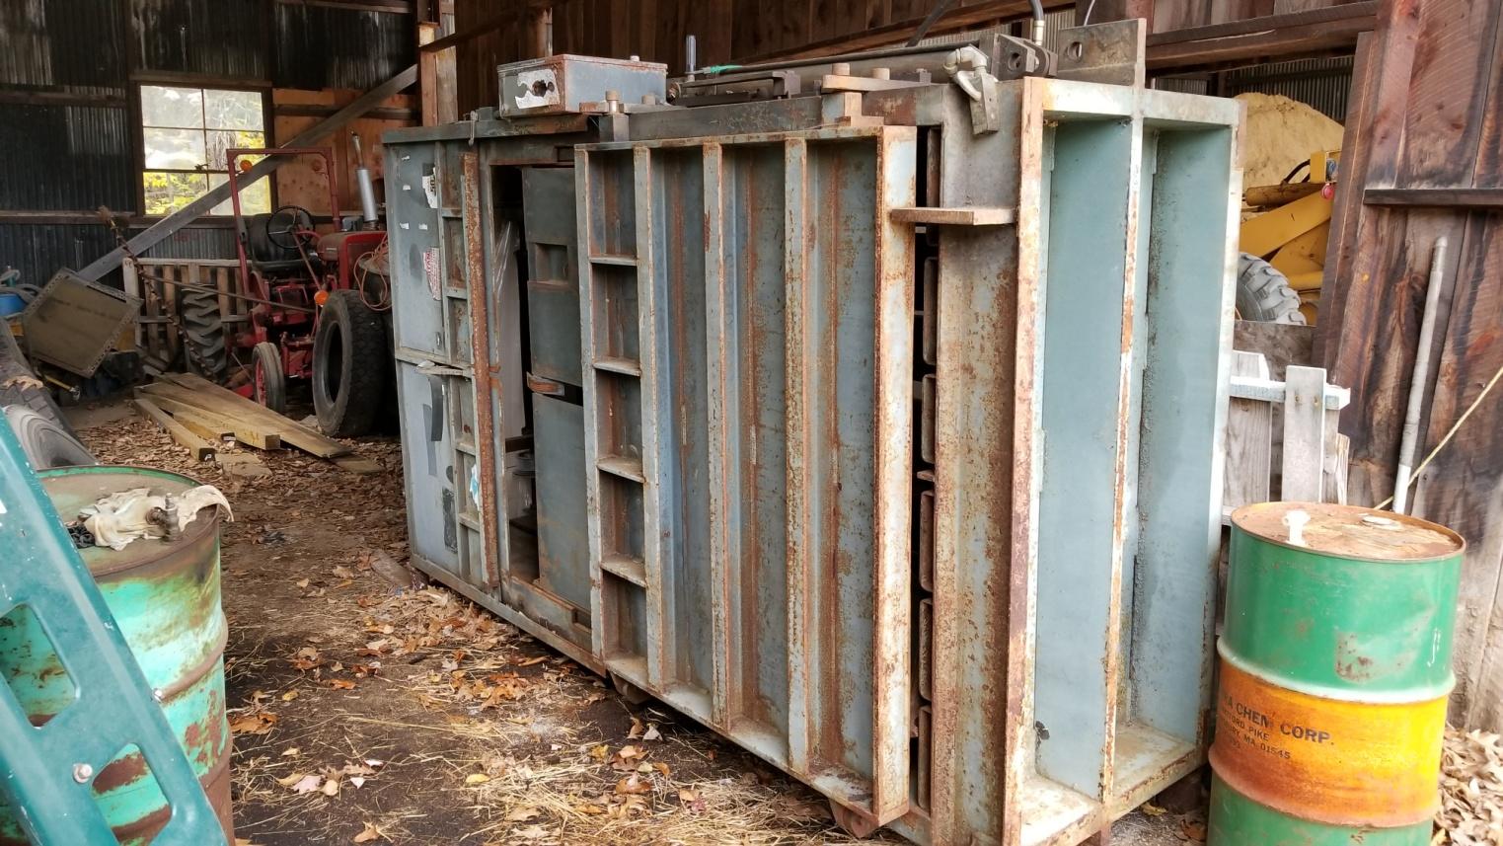
Separately recycle cardboard – Q & A
Could we refurbish the used baler stored in the Highway Department shed?
We question whether this baler can be fixed and operated cost-effectively. But this assumption should to be verified.
What does our used baler look like?

Slide 17
Recommendation #2 Replace our compactor truck with a new stationary compactor and breakaway container
This recommendation assumes a high probability of a near-term shutdown of the Wheelabrator trash-to-energy plant. If this shutdown occurs, then operating our own trash compactor truck becomes much less attractive.

Slide 18
Replace the compactor truck – Background
Today, Canterbury operates its own a compactor truck to haul its trash to the Wheelabrator plant at Exit 17 in Concord.
In contrast, all of the Transfer Stations we visited use stationary compactors.
And all, except for Loudon, contract with a commercial trash hauler to bring their container to/from their trash disposal site.
Loudon owns and operates its own tractor (cab) and wheeled trailer.
Our truck can haul about 7 tons of trash and we generate about 8 tons of trash per week.
Thus our truck normally makes one (but occasionally two) round trips to the Wheelabrator plant each week.
The closest available landfills to Canterbury are located in Rochester, NH and Berlin, NH.
Thus if the Wheelabrator plant shuts down, the SWC believes it would be cost-prohibitive and impractical to continue to operate our own trash truck, especially on days when the truck becomes full while the Transfer Station is still open.

Slide 19
Replace the compactor truck – Background
While operating our current truck we face two risks:
A near-term shut down of the Wheelabrator plant.
A truck failure that cannot be repaired cost-effectively.
Regarding Risk #1, the key question is: what is the probability that the Wheelabrator plant shuts down in 2019 or soon thereafter? It turns out that very recent events impact this probability.
From an article in the Union Leader, dated October 2, we learned that Wheelabrator Technologies, the owner of the Concord plant, is being sold to a new owner. This is the second sale of the company in the past 4 years.
The new owner, Macquarie Infrastructure Partners, is an “investment company.”
We have no idea what Macquarie plans to do with the plant.

Slide 20
Replace the compactor truck – Background
We also learned that the recently passed (9/13) Senate Bill 365, the so called “biomass” bill, which extended rate guarantees available to biomass power plants in New Hampshire by three years, also applied to the Concord Wheelabrator plant.
The passage of SB 365 bodes well for the continued operation of the plant, at least in the short term.
But as of a month ago it was not a done deal. And what happens after three years is still uncertain.
Whether these rate guarantees are enough to convince the new owner to continue operating the plant is unknown.
Whether the NH legislature renews the rate guarantees in three years is unknown.

Slide 21
Replace the compactor truck – Background
Regarding Risk #2, the SWC has not tried to (quantitatively) estimate the probability vs. time that our current truck will fail in a way that cannot be repaired cost-effectively.
The Canterbury Highway Department, using its own resources or a hired consultant, may be able to provide this estimate.
But with 20 years of operation under its belt, it is our opinion that the current truck is nearing the end of its service life.
Moreover, if a serious failure occurs then we may experience a period during which the Transfer Station could not accept trash.
Bottom line: given the uncertain future of the Wheelabrator plant, and the age of our compactor truck, the SWC feels that replacing the truck with a stationary compactor (and break-away container) in 2019 is a reasonable option to consider.

Slide 22
Replace the compactor truck – Investment
Estimated cost of a new stationary compactor with a 4 CY hopper and a 40 CY breakaway container, fully installed: $33,400.
Estimated cost to add a concrete pad on which the compactor and container would be placed: $3,200.
Estimated total investment to buy and install a new compactor and container: $36,600.
NOTE: This estimate assumes that the electrical work done for Recommendation #1 has been completed.

Slide 23
Replace the compactor truck – Budget impact
The cost to haul our container to and from the Wheelabrator plant is estimated to be $220 per trip.
We generate about 8 tons of trash per week or 416 tons/year.
Each ton of trash is equivalent to about 3 CY of compacted trash. Thus we generate about 24 CY of trash per week or 1250 CY per year.
The standard breakaway container we’re considering can hold up to 40 CY of compacted trash.
A commercial hauler cannot schedule trips as flexibly as we can using our own truck. In some weeks there may be more than 24 CY of trash. The compacted trash volume to weight ratio will not always 3 CY/ton.
Our commercial hauler will need to make a maximum of one round trip to the Wheelabrator plant each week or 52 trips per year.
Thus our worst case annual hauling costs will be $11,400. Actual hauling costs are expected to be less and could be significantly less if we purchase a 2nd container (See Q & A).

Slide 24
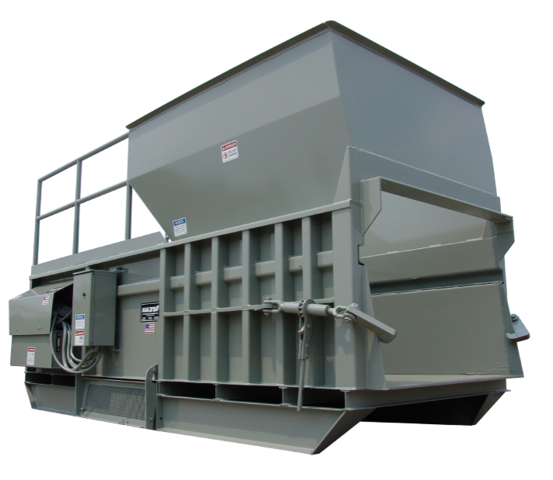
Compactor style we’re considering
Users toss trash into the 4 CY hopper
Opening for break-away container

Slide 25
Replace the compactor truck – Q & A
Where can we get more information about SB 365 and the sale of Wheelabrator Technologies?
You can read SB 365 here: https://legiscan.com/NH/text/SB365/id/1662352
SB 365 covers power plants that burn municipal waste with outputs up to 25 MW.
The maximum output of the Wheelabrator plant is 14 MW. https://www.wtienergy.com/plant-locations/energy-from-waste/wheelabrator-concord
We understand that the three-year effective term of SB 365 is defined in NH RSA Section 362-H:2,I(a).
You can read about the sale of Wheelabrator Technologies here: http://www.unionleader.com/apps/pbcs.dll/article?AID=/20181003/NEWS02/181009887

Slide 26
Replace the compactor truck – Q & A
How could a second breakaway container reduce hauling costs?
If we had two containers then we could connect one container to the compactor and store the other container nearby.
When the connected container is full, we would replace it with our empty container and arrange to have the now full disconnected container emptied by our hauler.
As long as the full disconnected container could be emptied before the connected container becomes full then the Transfer Station would always be able to accept trash and we would always send full containers to Wheelabrator.
This would result in the minimum annual hauling charge:
(1250 CY/year) / (40 CY/trip) = 32 trips/year
32 trips/year x $220/trip = $7,000/year.
The minimum hauling charge per ton can be calculated as $220/trip / (40 CY/ (3 CY/ton)) = $17/ton.
This represents a 25% add-on to our tipping fee of $ 67/ton.

Slide 27
Replace compactor truck – Q and A
So what’s the payback of buying a second container?
The container itself would cost about $11,000.
We also would need a second concrete pad: $3,200.
Thus total investment would be about $14,200.
We could calculate savings as the difference between our estimated “worst case” hauling charge (assumes one trip per week) and the expected hauling charge if we have two containers, that is: $11,400 - $7,000 = $4,400.
To be more realistic, we can assume that our single container annual hauling charge is $10,000 and thus a savings of $3,000.
This would result in an estimated payback period for buying a second container of $14,200/($3,000/year) = 4.7 years.
Thus a good case can be made for buying a second container.

Slide 28
Replace the compactor truck – Q & A
Why not buy a newer used compactor truck?
IF the Select Board expects the Wheelabrator plant will continue to operate for a few more years then this would be a reasonable option.
New trucks cost about $130k. 10 yr-old trucks about $50k. http://tomstrucksales.com/20-YD-Rear-Loaders-garbage-trucks-for-sale
One risk of this option is the cost of having to quickly sell (flip) the new truck in the event of a Wheelabrator plant closing. A second is that with (only) a 12-month notice, we may not be able to approve and purchase a new (used) truck in time to avoid driving to a distant landfill site or renting a truck for several weeks or months.
What if we do nothing and our current truck experiences a “catastrophic” failure (one we could not cost-effectively repair)?
Our best option would be to rent a replacement truck https://bigtruckrental.com/trucks/rear-loaders/
Assuming a rental fee of 20% of purchase price per year this would cost about $16k/yr.

Slide 29
Replace the compactor truck – Q & A
If we buy the stationary compactor, could we also buy and operate our own roll-on truck, like the ones used by commercial haulers, while the Wheelabrator continues to operate?
Maybe. But given the uncertainty about the Wheelabrator plant this would be a risky investment.
Will we need to modify the existing Transfer Station roofline?
No. The stationary compactor and break-away container we’re considering would not require this.
However, if the Town decides to continue recycling mixed paper then we may need to extend the roofline to cover the mixed paper container, assuming it is an open container. But this is not certain. And in the short run we can use a tarp.
Is the stationary compactor hopper as big as the one in our current truck?
Yes. Big enough for residents to toss in items as large as sofas.

Slide 30
Recommendation #3 Rent a mobile office container before the start of winter
The mobile office would provide a heated space for Transfer Station staff and a secure location to store green bags and cash. It also would provide a heated space for first aid equipment as required by NH regulations governing municipal facilities such as Transfer Stations. Thus it would solve several problems until we decide whether to add a heated office to the existing Transfer Station building.

Slide 31
Mobile office container – Background
Today the Transfer Station staff have access to an office in the Transfer Station building that is neither heated nor air conditioned.
It also has a flimsy door and no secure space to store green bags, which are instead stored in a cage at the other end of the Transfer Station building.
This cage would be useful for cardboard recycling.

Slide 32
Mobile office container – Regulatory argument
In addition to the reasons cited above, a critical and immediate reason for renting the mobile office container is regulatory.
The New Hampshire Code of Administrative Rules ENV-SW 404.03 (a) Design Features and Appurtenances requires that a facility such as our Transfer Station include:
(11) Shelter for facility operators;
(12) Sanitation facilities for facility operators;
(13) First aid station for facility operators;
(15) Office or other area for maintaining and storing facility records
One required element of the first aid station is an eye wash station. But our current unheated room would not prevent an eye wash station from freezing. It therefore makes the Transfer Station uncompliant with the NH regulation cited above.
Renting a heated mobile office container before winter starts would address this regulatory issue.

Slide 33
Mobile office container – Details
For at least the short term we recommend renting a mobile office container, such as the one shown on a later slide.
It can be rented for $150 per month or $1,800 per year. There is also a setup fee of $125.
The model we’ve considered meets all of our winter, summer, and security requirements.
In the long term the Town may want to consider remodeling the Transfer Station building to include a heated, air conditioned, and secure office. However, this option has not yet been estimated by the SWC.

Slide 34
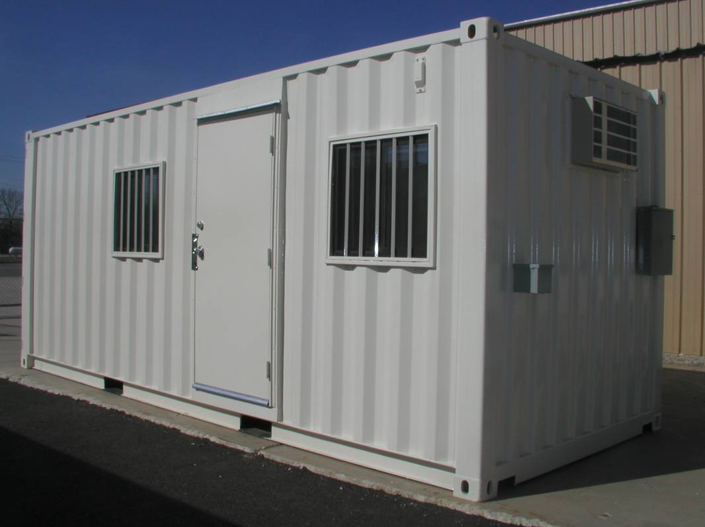
Mobile office container – Example

Slide 35
Recommendation #4 At our 2019 Town Meeting, ask voters to decide whether to send mixed paper to the trash-to-energy plant, or continue to recycle it.
The SWC could not come to a consensus on this issue.

Slide 36
Mixed paper – Trash-to-energy or recycle
Assumptions
Mixed paper volume:
84 tons/year
7 tons/month
21 CY/month (assuming 3CY per ton)
5 CY per week
Cost to recycle mixed paper: $95/ton
Cost to dispose of trash (tipping fee): $67/ton
Savings if we send mixed paper to Wheelabrator trash-to-energy plant
Savings per ton: $28/ton ($95/ton – $67/ton)
Annual savings: $ 2,400 ($28/ton x 84 tons/year)

Slide 37
Mixed paper: Trash-to-energy or recycle?
Many towns in our area have decided to continue to recycle cardboard but discontinue recycling mixed paper. This is because the revenue from cardboard is far above the costs associated with processing it, while the cost of recycling mixed paper is currently higher than the cost of disposing it as trash. In addition, towns served by the Wheelabrator trash-to-energy plant know that the mixed paper they dispose of as trash will be incinerated to produce electricity, which is generally considered more environmentally friendly then sending it to a landfill.
The solid waste committee is divided as to whether Canterbury should follow suit.
The argument in favor of treating mixed paper as part of the waste stream is pretty straightforward, if we continue to operate our own trash truck. First, we estimate that it would save the town about $2,400/year in recycling costs. Second, the environmental impact is relatively small because sending it to the Wheelabrator trash-to-energy incinerator is essentially generating electricity from a renewable fuel.
In our opinion, residents should be allowed to toss their mixed paper into the truck without putting it in green bags. Thus, disposing of mixed paper as trash would reduce transfer station net operating costs without requiring residents to buy more green bags.

Slide 38
Mixed paper: Trash-to-energy or recycle?
The argument for continuing to recycle mixed paper is that virgin paper production is one of the most environmentally harmful industries on earth. Canterbury has a long history of supporting environmental policies from the mandatory recycling ordinance to the pay-as-you-throw ordinance to the results of the recent recycling survey. Furthermore there is some question as to whether the mandatory recycling ordinance allows for treating recyclable materials as trash, and whether the pay-as-you-throw ordinance allows a policy of throwing anything into the truck that is not in a green bag.
Because the members of the SWC did not reach consensus as to whether to recommend that we send mixed paper to the Wheelabrator trash-to-energy plant or continue to recycle it, we suggest that the Select Board submit this question to the voters at our 2019 Canterbury Town Meeting. The warrant article should be worded broadly enough to cover not only the immediate issue of mixed paper but also any other material that might fall into the same cost/benefit conundrum.
However, all SWC members agree that if the Select Board decides to dispose of mixed paper as trash, then this decision should be revisited in the event that the Wheelabrator trash-to-energy plant is shut down.

Slide 39
Mixed paper – Q and A
If we send mixed paper to Wheelabrator, won’t this increase our hauling fee and thus decrease the estimated savings?
If we schedule one trip per week for trash, and the volume of the average trash load is 24 CY, then our container will typically have a spare capacity of 16 CY.
Our estimated mixed paper volume is 5 CY per week.
Thus even in weeks when the trash volume is greater than average, there should be enough spare capacity to hold our expected volume of mixed paper.

Slide 40
Recommendation #5 Establish two traffic lanes around the Transfer Station building.
The added lane will improve traffic flow on busy days.

Slide 41
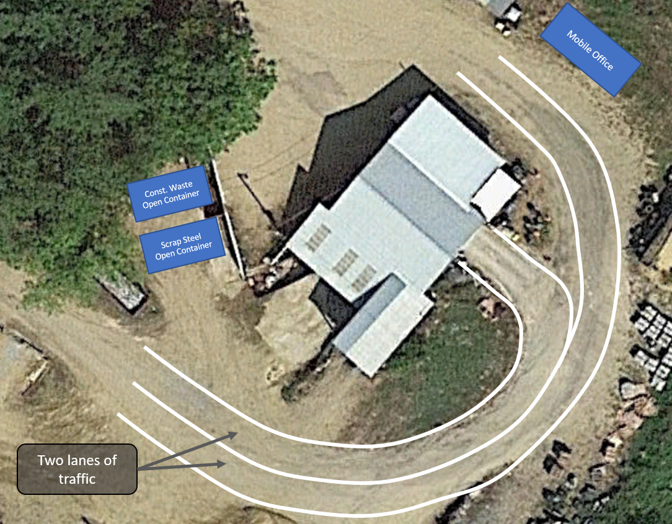
Establish two traffic lanes around the TS building
At little cost we can significantly improve traffic flow, especially on busy days when cars are lined up at the building entrance.

Slide 42
Recommendation #6 Budget for minor site work, minor building modifications, and contingencies.
Needed by previous recommendations.

Slide 43
Budget for site work, building mods, etc.
The SWC recommends budgeting for the minor site work and building modifications needed to implement the other recommendations, and for contingencies, in other words the “unknown unknowns.”
Site work could include:
Regrading to allow for the 2nd traffic lane.
Preparing a site for the mobile office container.
Preparing a site for the additional container needed to store large cardboard bales.
Building modifications could include:
Improved doorway into the cardboard recycling room.
Modifying the locations, if needed, of the current aluminum and plastic recycling windows.
Adding a doorway on the North side of the TS building for users who don’t want to drive through.

Slide 44
Price quotes and what’s next

Slide 45
Price quotes: New compactor and hauling
What | From | Amount | Notes
Stationary Compactor (2 CY) - new | Casella | $22k | Installed, with VFD
 | Dumpster Depot | $16 – 18k | Installed, with VFD
 | Recycling Mechanical | $18.5k | Installed, with VFD
Compactor (2 CY) - used | Recycling Mechanical | $12k | Installed, with VFD
Compactor (2 CY) - rental | Casella | $628/mo. | Installed, with VFD
Trash Container (40 CY) - rental | Casella | $175/mo. | ~ Twice current truck capacity
 | Dumpster Depot | $120/mo. | ~ Twice current truck capacity
Hauling charge – to/from Wheelabrator | Casella | $288/trip | 5 year contract
 | Dumpster Depot | $220/trip | 2 or 3 year contract
Upgrade electrical service to 400A | Unitil | $22K | Needed for new compactor
Compactor (4 CY) and container | Maguire Equipment | $33k | Installed, with VFD
Note: Trash tipping fee of $67/ton will not change until end of our current Wheelabrator contract.

Slide 46
Price quotes: Cardboard recycling and other
What | From | Amount | Notes
60-inch baler - new | Recycling Mechanical | $12k | Installed, with VFD
 | Casella | $10k | Installed, with VFD
 | Maguire Equipment | $10k | Installed, with VFD
60-inch baler - used | Recycling Mechanical | $5.5k | Installed, with VFD
60-inch baler – rental | Casella | $450/mo.
Ground storage container | NRRA | $4.5k
Upgrade to 400 A service | Unitil | $ 22 k | Vs. $130 k for three-phase power
Upgrade building electrical | Martin Electric | $ 11 k | Does not include the wiring expected to be done by the compactor and baler installers.
Office trailer - rental | Tilton Trailer | $150/mo. | Setup fee is $125.

Slide 47
Future – Our to do list
The Town should consult with other members of our Trash Cooperative and get their view on the future of the Wheelabrator plant. Another option is to get a statement from a contact at Wheelabrator Technologies, or its new parent company.
Get better data on renting or buying a replacement compactor truck. How much. How long it would take.
Decide what to do about plastic recycling:
Continue what we’re doing now.
Separate into more types.
Combine into a single stream when new recycling methods become available to us, such as converting plastics into fuel.
What are the benefits of buying a 2nd large baler for aluminum and plastic.
Develop a plan for 2020 (and beyond) that may include more significant modifications to our existing facility.

